Slide 1
Murach’s C# (8th Edition)
Chapter 5
How to code control structures

Slide 2
Objectives
Applied
Given a Boolean expression and the values for the variables in the expression, evaluate the expression.
Use if statements, switch statements, and switch expressions as needed within your apps.
Use while, do-while, and for statements as needed within your apps.
Knowledge
Compare the if-else and switch statements.
Compare switch statements and switch expressions.
Describe the use of pattern matching with if statements, switch statements, and switch expressions.
Compare the if-else statement and the conditional operator.

Slide 3
Objectives (continued)
5. Describe the differences between while, do-while, and for loops.
6. Explain how the break and continue statements work when used within a loop.
7. Describe the use of breakpoints, the Locals window, and stepping through code as they apply to debugging errors within loops.
8. Describe block scope in the context of the control structures.

Slide 4
Relational operators
==
!=
>
<
>=
<=

Slide 5
Examples that use relational operators
firstName == "Frank"
txtYears.Text == ""
message == null
discountPercent == 2.3
isValid == false
code == productCode
lastName != "Jones"
years > 0
i < months
subtotal >= 500
quantity <= reorderPoint

Slide 6
Logical operators
&&
||
&
|
!

Slide 7
Examples that use logical operators
subtotal >= 250 && subtotal < 500
timeInService <= 4 || timeInService >= 12
isValid == true & counter++ < years
isValid == true | counter++ < years
date > startDate && date < expirationDate ||
isValid == true
((thisYTD > lastYTD) || empType=="Part time") &&
startYear < currentYear
!(counter++ >= years)

Slide 8
If statements without else if or else clauses
if (subtotal >= 100)
discountPercent = .2m;
if (subtotal >= 100)
{
discountPercent = .2m;
status = "Bulk rate";
}

Slide 9
An if statement with an else clause
if (subtotal >= 100)
discountPercent = .2m;
else
discountPercent = .1m;

Slide 10
An if statement with else if and else clauses
if (subtotal >= 100 && subtotal < 200)
discountPercent = .2m;
else if (subtotal >= 200 && subtotal < 300)
discountPercent = .3m;
else if (subtotal >= 300)
discountPercent = .4m;
else
discountPercent = .1m;

Slide 11
Nested if statements
if (customerType == "R")
{
if (subtotal >= 100) // begin nested if
discountPercent = .2m;
else
discountPercent = .1m; // end nested if
}
else // customerType isn't "R"
discountPercent = .4m;

Slide 12
A switch statement with a default label
switch (customerType)
{
case "R":
discountPercent = .1m;
break;
case "C":
discountPercent = .2m;
break;
default:
discountPercent = .0m;
break;
}

Slide 13
A switch statement that falls through the first case label
switch (customerType)
{
case "R":
case "C":
discountPercent = .2m;
break;
case "T":
discountPercent = .4m;
break;
}

Slide 14
A switch expression that uses a discard
discountPercent = customerType switch
{
"R" => .1m,
"C" => .2m,
_ => .0m
};

Slide 15
A switch expression with two cases that return the same result
discountPercent = customerType switch
{
"R" => .2m,
"C" => .2m,
"T" => .4m,
_ => .0m
};

Slide 16
A switch expression with expressions that perform a calculation
discountAmount = customerType switch
{
"R" => subtotal * .2m,
"C" => subtotal * .2m,
"T" => subtotal * .4m,
_ => .0m
};

Slide 17
Types of patterns used with pattern matching
Constant pattern
Discard pattern
Relational pattern
Logical pattern
Declaration pattern
Type pattern

Slide 18
A switch expression with relational patterns
discountAmount = subtotal switch
{
< 100 => 0m,
<= 200.0m => subtotal * .2m,
<= 500.0m => subtotal * .3m,
_ => subtotal * .4m
};

Slide 19
A switch expression with logical patterns
discountAmount = subtotal switch
{
>= 100.0m and <= 200.0m => subtotal * .2m,
> 200.0m and <= 500.0m => subtotal * .3m,
> 500.0m => subtotal * .4m,
_ => .0m
};

Slide 20
An if statement with constant and logical patterns
string? message = null;
if (message is not null) {
// code that uses the message variable
}

Slide 21
An if statement with a declaration pattern
Object message = "This is a string literal.";
if (message is string stringMessage) {
// code that uses the stringMessage variable
}

Slide 22
A conditional expression
subtotal >= 100 ? .1m : .05m

Slide 23
How to use a conditional operator to set the value of a variable
decimal discountPercent = subtotal >= 100 ? .1m : .05m;

Slide 24
A statement that uses parentheses to identify the Boolean expression
decimal discountPercent = (subtotal >= 100) ? .1m : .05m;

Slide 25
An if statement that performs the same task
decimal discountPercent;
if (subtotal >= 100)
discountPercent = .1m;
else
discountPercent = .05m;

Slide 26
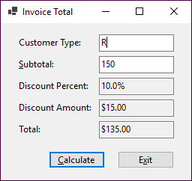
The enhanced Invoice Total form

Slide 27
The event handler for the Click event of the Calculate button
private void btnCalculate_Click(
object sender, EventArgs e)
{
string customerType = txtCustomerType.Text;
decimal subtotal =
Convert.ToDecimal(txtSubtotal.Text);
decimal discountPct = .0m;
if (customerType == "R")
{
if (subtotal < 100)
discountPct = .0m;
else if (subtotal >= 100 && subtotal < 250)
discountPct = .1m;
else if (subtotal >= 250)
discountPct =.25m;
}

Slide 28
The event handler for the Click event of the Calculate button (continued)
else if (customerType == "C")
{
if (subtotal < 250)
discountPct = .2m;
else
discountPct = .3m;
}
else
{
discountPct = .4m;
}
decimal discountAmt = subtotal * discountPct;
decimal invoiceTotal = subtotal - discountAmt;
txtDiscountPct.Text = discountPct.ToString("p1");
txtDiscountAmt.Text = discountAmt.ToString("c");
txtTotal.Text = invoiceTotal.ToString("c");
txtCustomerType.Focus();
}

Slide 29
A while loop that adds the numbers 1 through 4
int i = 1, sum = 0;
while (i < 5)
{
sum += i;
i++;
}

Slide 30
A while loop that calculates a future value
int i = 1;
while (i <= months)
{
futureValue = (futureValue + monthlyPayment) *
(1 + monthlyInterestRate);
i++;
}

Slide 31
A do-while loop that calculates a future value
int i = 1;
do
{
futureValue = (futureValue + monthlyPayment) *
(1 + monthlyInterestRate);
i++;
}
while (i <= months);

Slide 32
A for loop that stores the numbers 0 through 4 in a string
string numbers = "";
for (int i = 0; i < 5; i++)
numbers += i + " ";

Slide 33
Another for loop that stores the numbers 0 through 4 in a string
string numbers = "";
for (int i = 0; i < 5; i++)
{
numbers += i;
numbers += " ";
}

Slide 34
A for loop that adds the numbers 8, 6, 4, and 2
int sum = 0;
for (int j = 8; j > 0; j-=2)
{
sum += j;
}

Slide 35
A for loop that calculates a future value
for (int i = 1; i <= months; i++)
{
futureValue = (futureValue + monthlyPayment) *
(1 + monthlyInterestRate);
}

Slide 36
A loop with a break statement
string message = "";
int i = 1;
while (i <= months)
{
futureValue = (futureValue + monthlyPayment) *
(1 + monthlyInterestRate);
if (futureValue > 100000)
{
message = "Future value is too large.";
break;
}
i++;
}

Slide 37
A loop with a continue statement
string numbers = "";
for (int i = 1; i < 6; i++)
{
numbers += i;
numbers += "\n";
if (i < 4)
continue;
numbers += "Big\n";
}
The result of the loop
1
2
3
4
Big
5
Big

Slide 38
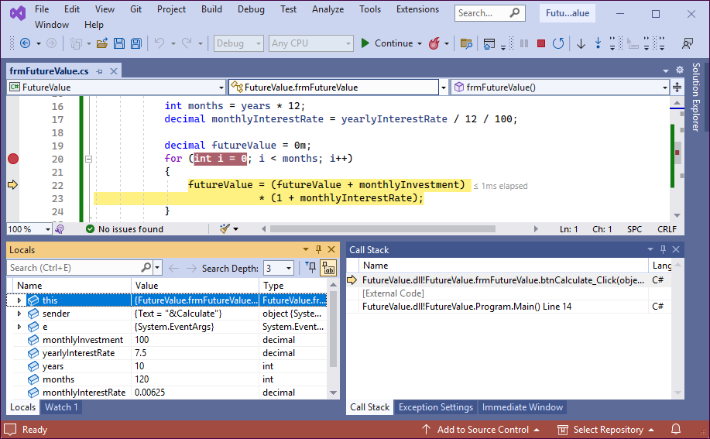
A for loop with a breakpoint and an execution point

Slide 39
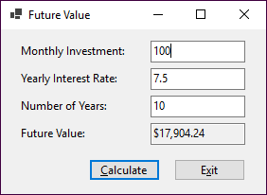
The Future Value form

Slide 40
Two of the property settings for the FV form
The TextAlign property of each of the labels is set to MiddleLeft.
The TabIndex properties of the controls are set so the focus moves from top to bottom and left to right.

Slide 41
The first event handler in the Future Value app
private void btnCalculate_Click(object sender, EventArgs e)
{
decimal monthlyInvestment =
Convert.ToDecimal(txtMonthlyInvestment.Text);
decimal yearlyInterestRate =
Convert.ToDecimal(txtInterestRate.Text);
int years = Convert.ToInt32(txtYears.Text);
int months = years * 12;
decimal monthlyInterestRate =
yearlyInterestRate / 12 / 100;
decimal futureValue = 0m;
for (int i = 0; i < months; i++)
{
futureValue = (futureValue + monthlyInvestment)
* (1 + monthlyInterestRate);
}
txtFutureValue.Text = futureValue.ToString("c");
txtMonthlyInvestment.Focus();
}

Slide 42
The second event handler in the Future Value app
private void btnExit_Click(object sender, EventArgs e)
{
this.Close();
}

